Slide 1

Zero Trust at the Endpoint
Fighting ransomware with Allowlisting and Ringfencing™
Collin Ellis
Senior Solutions Engineer

Slide 2
What is Zero Trust?
The term “Zero Trust Architecture” means a security model, a set of system design principles, and a coordinated cybersecurity and system management strategy based on an acknowledgment that threats exist both inside and outside traditional network boundaries. The Zero Trust security model eliminates implicit trust in any one element, node, or service. Instead, it requires continuous verification of the operational picture via real-time information from multiple sources to determine access and other system responses. In essence, a Zero Trust Architecture allows users full access but only to the bare minimum they need to perform their jobs.

Slide 3


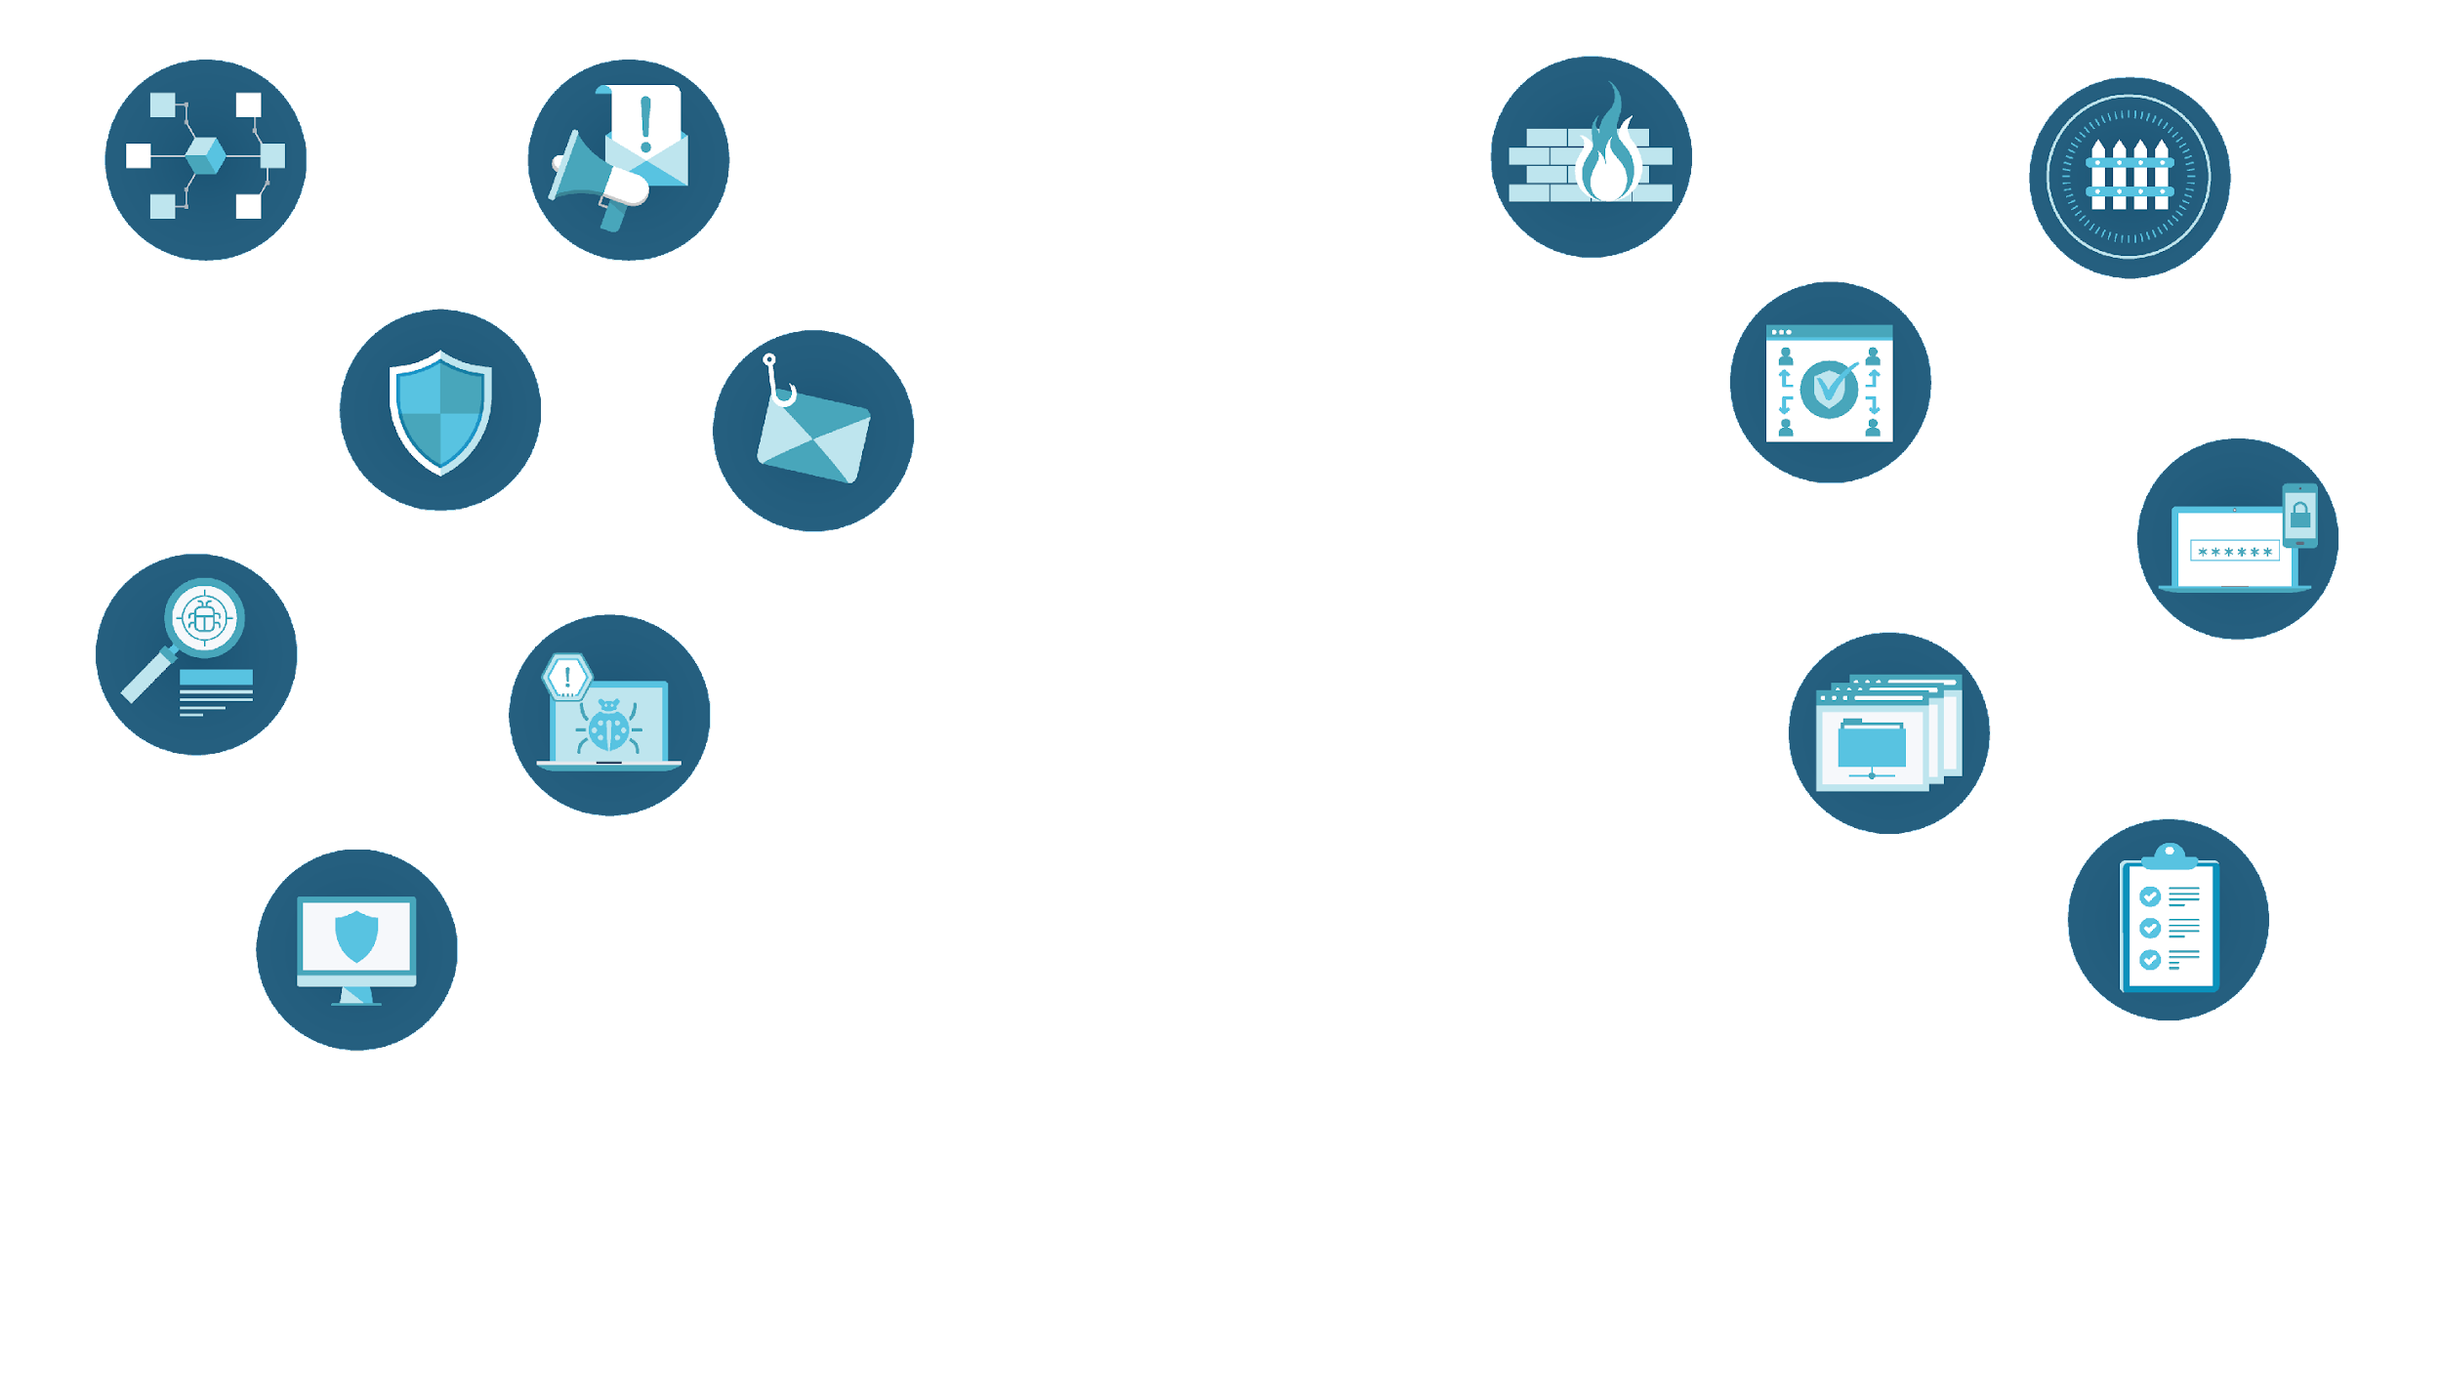
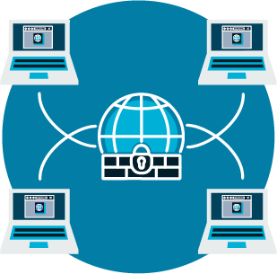

IDS/IPS
Web/
Email
Anti-Spam
Firewall
Ringfencing Policies
Network
Antivirus
Elevation Control
Anti-Phishing
Controls
Detection
Insider Threat
Dual Factor Authentication
Threat
Hunting
Applications
EDR
Storage Control
Application Whitelisting
Endpoint
MDR
Human
Network Access Control
Security Awareness Training
Notes:
Controls
App
Ringfence
Elevation
* Storage
Nac
Changing the conversation around Security Awareness Training

Slide 4
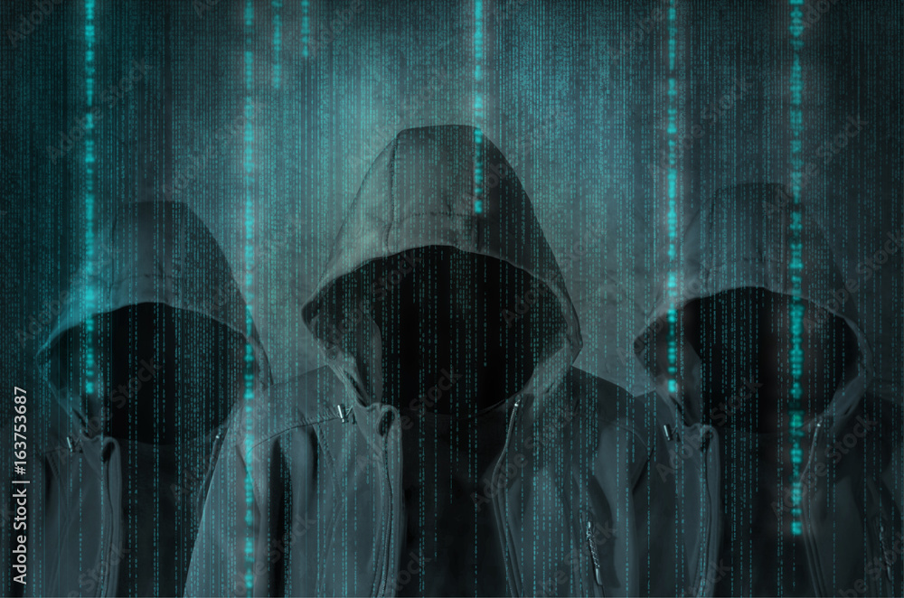



Who Are Your Adversaries?
Sophisticated Businesses
Nation States
Gangs

Slide 5
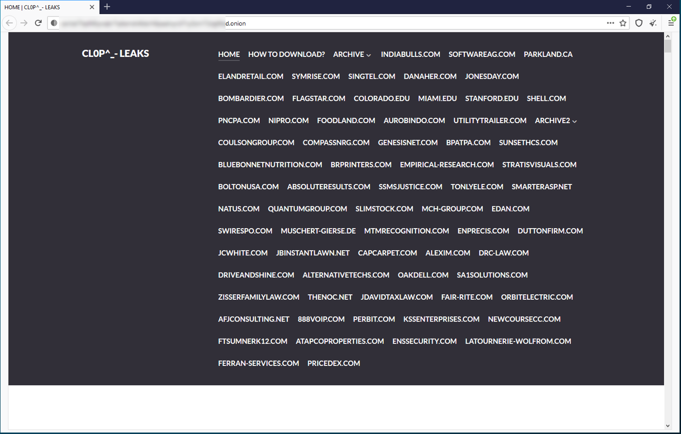
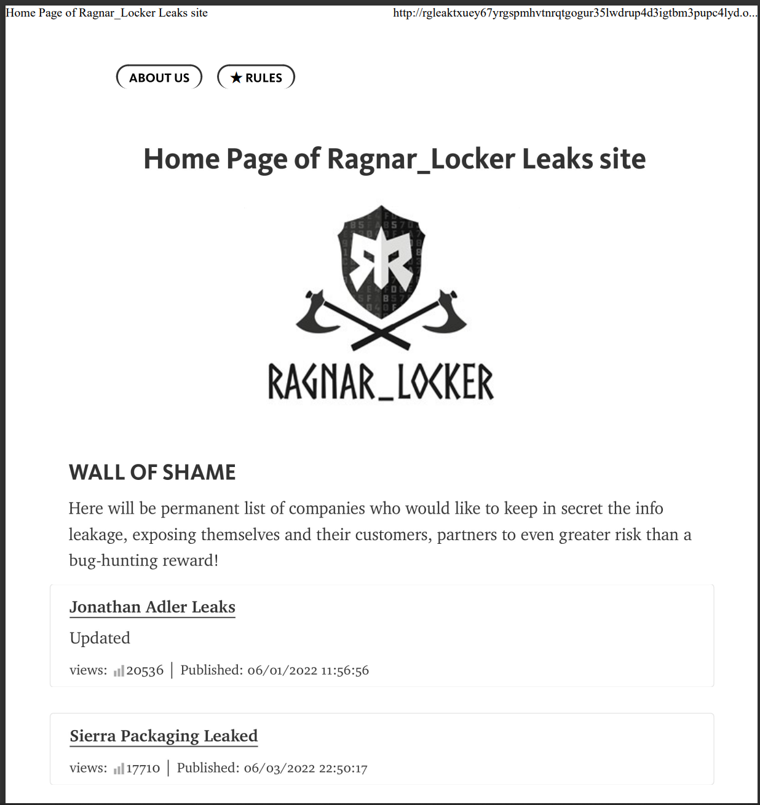
Ransomware Gangs

Slide 6
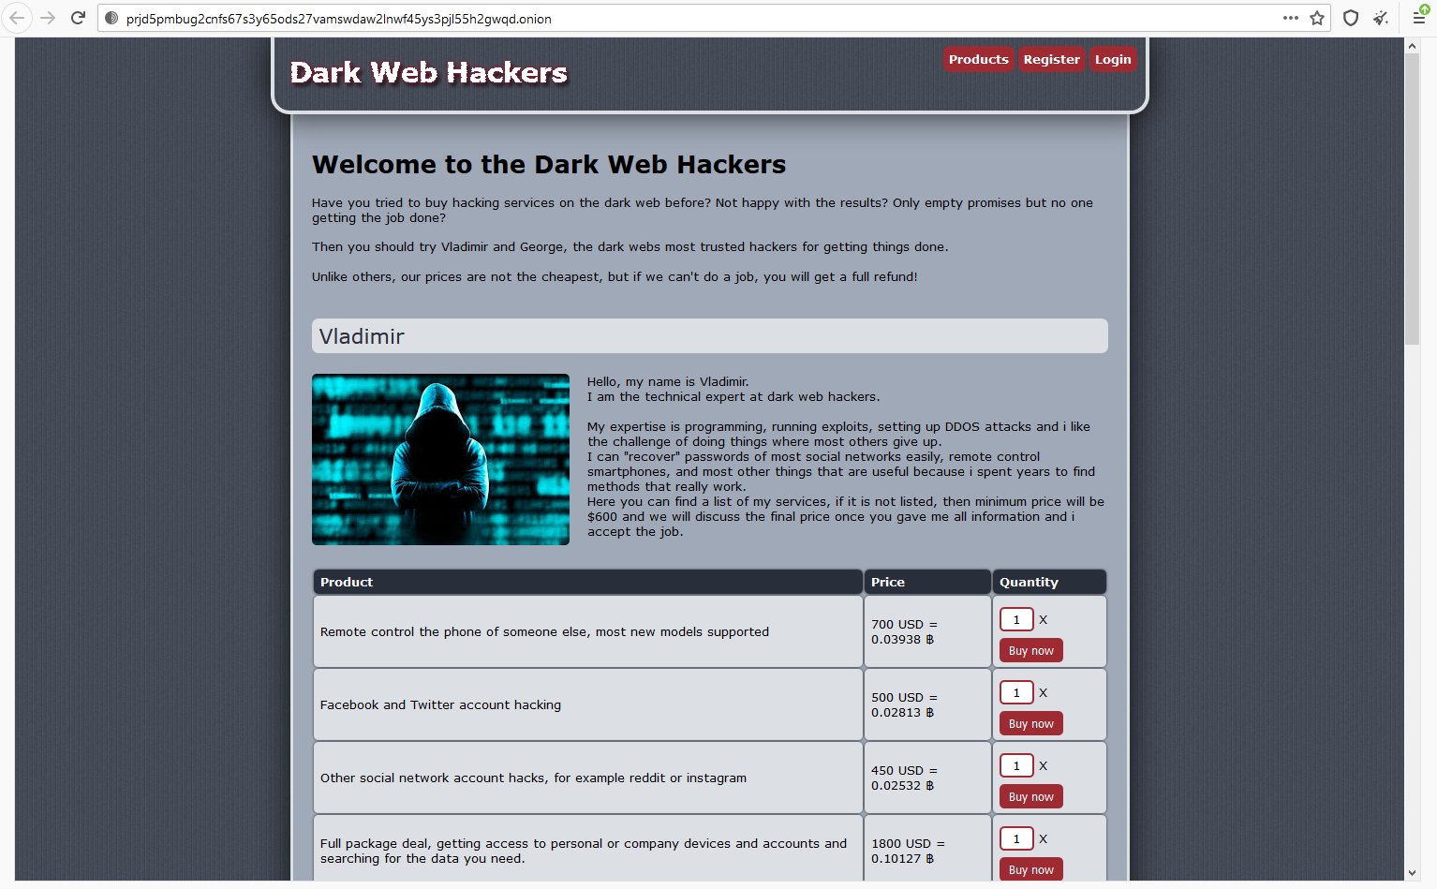
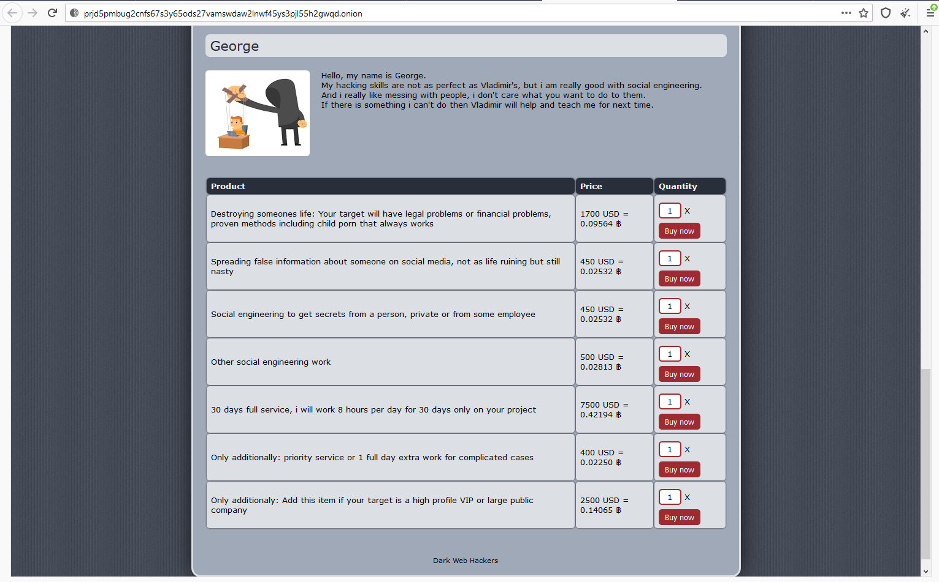
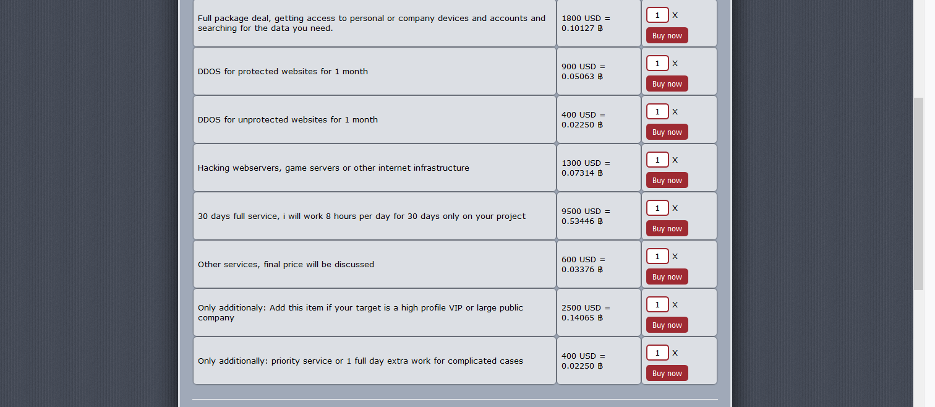
Sophisticated Businesses

Slide 7

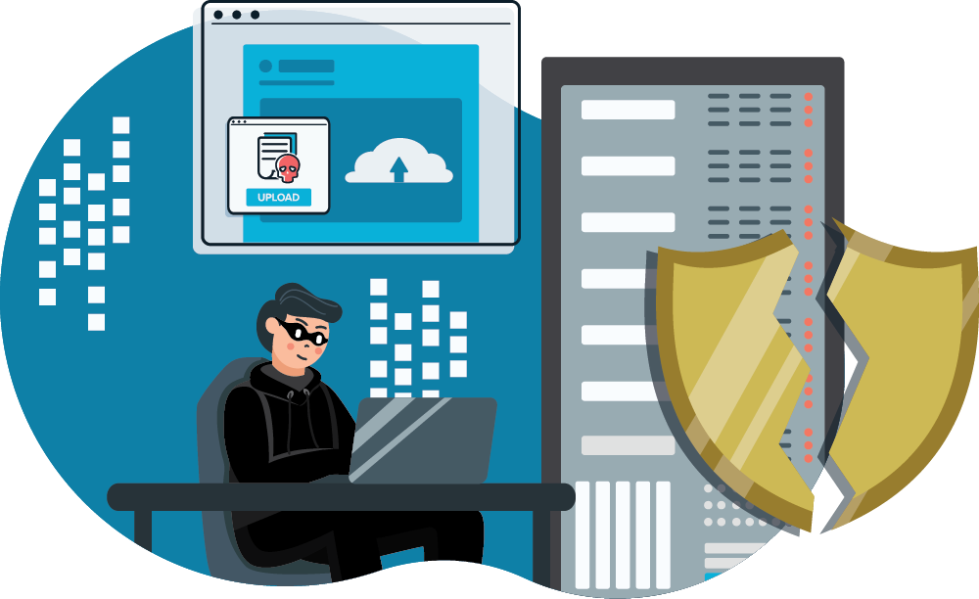
How can vulnerabilities
(and “features”) be used by attackers?
Notes:
Known and Trusted tools are misused
The cycle of chasing a patch because of human error
Not if but when
When that time comes what should our tools be capable of doing?

Slide 8




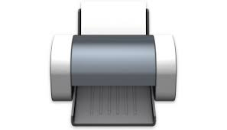

They Exploit The Entire Industry
Over 21,000 more!
Notes:
Exchange- Spooler-Log4j-Follina (Examples of human error in dev cycle) They all granted unauthorized access and then allowed a payload to be delivered.
Unauthorized Access lead to the Solar Winds and Kaseya VSA supply chain attacks.
We want to give you control of what your software is capable of actually doing – without being a developer ;)

Slide 9
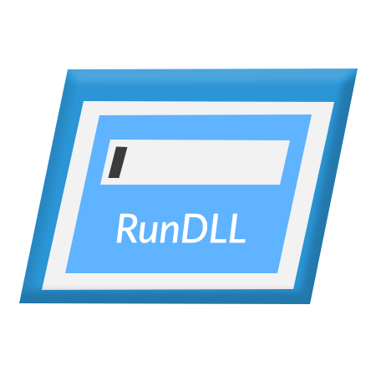


Living off the Land
Command Prompt
PowerShell
RunDLL

Slide 10
Dark Web Resources
Ransomware Gang Research Site
Dark Web Markets Research
Hidden Wiki

Slide 11
Thank You

